Slide 1

Unit 5:
Ethics in SE
Hacking
Software Engineering in Global Environment

Slide 2
ETHICS:
Ethics addresses any intentional action that impacts negatively or positively the lives and values of others
Professional ethics are principles that govern the behaviour and judgements of a person while performing his profession
Given that most population of the world directly or indirectly use software systems, the decisions made by the software engineer and the values embedded therein will effect the lives of people.
The activity of Professional Software Engineering Ethics takes place when any decision made by computing professionals during the design, development, construction and maintenance of computing artifacts affect other people. These decisions may be made by individuals, teams, management, or the profession.
These decisions (technical or otherwise) needs to be guided by, with a commitment towards ethical human values. This can be achieved by becoming more sensitive to the long-term human relations implications of our work and incorporating this sensitivity into our software designs and products
Notes:
A good
software engineering decision requires an awareness of and a careful consideration of
Gotterbarn Software Engineering Ethics Research Institute 2
both the technical and the ethical dimensions The technical decisions should be
consciously guided by values. An absence of the awareness of this relationship between
technology and values means that the values related to the technology are haphazard.
Professions describe these values in Codes of Ethics, Codes of Conduct and Codes of
Practice. These codes serve many functions related to a profession including providing
guidance for practitioner’s ethical choices and educating practitioners and the public about
the ethical standard of the profession.
Codes of ethics are statements about the interaction of technology and values. They are
also intended to insure that this interaction is not haphazard. Some codes, such as the
Australian Computer Society Code of Ethics carries legal weight to insure structured
interaction, while other codes, such as the Software Engineering Code of Ethics and
Professional Practice, rely on normative pressures. The goal of all of these codes is to
make sure that the activity of practicing professionals as individual, teams, management,
or professional organizations, advance and protect human values rather than do d
1

Slide 3
ETHICS:
These can be guided under the headings of
Codes of Ethics Guiding principles or boundaries in understanding the difference between Right/Wrong that can be used by individuals acting as free moral agents to make choices to guide their behaviour Integrity. Objectivity. Professional competence. Confidentiality Professional Behaviour (Cost/Work/ Use and Abuse of resources) No Plagiarism and respect for Intellectual Property | Codes of Conduct / Practice How an employee will need to behave in the workplace on a day-to-day basis a specific set of professional behaviours and values the professional must know and must abide by Equality and fairness Empathy and respect Performing to one’s best capability Obedience to the law Privacy Following standard practices and standards Portraying realistic competence levels & should contribute in the areas of competence
Notes:
A good
software engineering decision requires an awareness of and a careful consideration of
Gotterbarn Software Engineering Ethics Research Institute 2
both the technical and the ethical dimensions The technical decisions should be
consciously guided by values. An absence of the awareness of this relationship between
technology and values means that the values related to the technology are haphazard.
Professions describe these values in Codes of Ethics, Codes of Conduct and Codes of
Practice. These codes serve many functions related to a profession including providing
guidance for practitioner’s ethical choices and educating practitioners and the public about
the ethical standard of the profession.
Codes of ethics are statements about the interaction of technology and values. They are
also intended to insure that this interaction is not haphazard. Some codes, such as the
Australian Computer Society Code of Ethics carries legal weight to insure structured
interaction, while other codes, such as the Software Engineering Code of Ethics and
Professional Practice, rely on normative pressures. The goal of all of these codes is to
make sure that the activity of practicing professionals as individual, teams, management,
or professional organizations, advance and protect human values rather than do d
These codes serve many functions related to a profession including providing guidance for practitioner’s ethical choices and educating practitioners and the public about the ethical standard of the profession
1

Slide 4
ETHICS: Software Engineering Code of Ethics and Professional Conduct
These are eight principles
PUBLIC - Software engineers shall act consistently with the public interest.
CLIENT AND EMPLOYER - Software engineers shall act in a manner that is in the best interests of their client or employer and that is consistent with the public interest.
PRODUCT - Software engineers shall ensure that their products and related modifications meet the highest professional standards possible.
JUDGMENT - Software engineers shall maintain integrity and independence in their professional judgment.
MANAGEMENT - Software engineering managers and leaders shall subscribe to and promote an ethical approach to the management of software development and maintenance.
PROFESSION - Software engineers shall advance the integrity and reputation of the profession consistent with the public interest.
COLLEAGUES - Software engineers shall be fair to and supportive of their colleagues.
SELF - Software engineers shall participate in lifelong learning regarding the practice of their profession and promote an ethical approach to the practice of the profession.
Notes:
A good
software engineering decision requires an awareness of and a careful consideration of
Gotterbarn Software Engineering Ethics Research Institute 2
both the technical and the ethical dimensions The technical decisions should be
consciously guided by values. An absence of the awareness of this relationship between
technology and values means that the values related to the technology are haphazard.
Professions describe these values in Codes of Ethics, Codes of Conduct and Codes of
Practice. These codes serve many functions related to a profession including providing
guidance for practitioner’s ethical choices and educating practitioners and the public about
the ethical standard of the profession.
Codes of ethics are statements about the interaction of technology and values. They are
also intended to insure that this interaction is not haphazard. Some codes, such as the
Australian Computer Society Code of Ethics carries legal weight to insure structured
interaction, while other codes, such as the Software Engineering Code of Ethics and
Professional Practice, rely on normative pressures. The goal of all of these codes is to
make sure that the activity of practicing professionals as individual, teams, management,
or professional organizations, advance and protect human values rather than do d
1

Slide 5
Hacking
Hacking as a terminology historically was used constructively in terms of cleverness or an ability to move ahead in spite of strong obstacles or challenges
Hacking entails some form of excellence, for example exploring the limits of what is possible thereby doing something exciting and meaningful.
Currently it gets used more often with criminality in terms of gaining unauthorized access to systems and resources which were not intended for.
Criminal hacking typically involves using psychology to trick a user into unknowingly giving information or data to the hacker typically called social engineering
Hacking targeting individuals and organizations is a non-acceptable social norm and have number of laws/bills across the globe making it to be a punishable offence

Slide 6
Hacker and Engineer
A hacker would go about solving a problem by using non standard approaches or by exploiting its weakness. They need novelty, typically are attracted by challenges and the toys they work with and are weakly motivated by conventional rewards like money, positions etc.
An engineer is someone who mostly takes something that is known to be possible, and makes it fit within a given, limiting set of criteria like within a fixed budget, to meet a performance benchmark, to exceed certain reliability requirements, to make it aesthetically pleasing, meet arbitrary regulations (accessibility, environmental, paying living wages, etc.). There could be more creative and original thinking given the constraints of the engineering problem.
Hackers who use deep understanding and knowledge of computer systems and software and look to exploit weakness of systems can be classified into two types
White hat hackers
These strive to improve the security of an organization's security systems by finding vulnerable flaws so that they can prevent cybercrimes before the black hats notice.
Black hat hackers
Look to somehow subvert that technology, for stealing something valuable or other malicious reasons like disrupting reputation, corporate espionage and as part of nation-state hacking

Slide 7
Contrasting Hacking and Software Engineering
A Hacker always try's to stretch what's possible or what exists. Once something is functional and successful the hacker moves on to another problem. Engineer picks a problem makes it fit within a given set of limiting criteria as part of solving it
Some of the examples of hacking would be creation of Linux etc.
At times, hacking involves poking around approaches towards a solution. So if this leads to a solution, it may not be easy to look back and see how this was achieved. Engineering involves crafting a solution understanding why and the considering the best practices. So the level of awareness of how of the solution is different.
Considering Hacking and Engineering as more of an approach, its necessary to hack and to engineer at different times. Its more to know when you need to pick one over the other

Slide 8

Software Engineering in a Global Environment

Slide 9

Global Environment
Traditional team
Social group of individuals collocated
Tasks are interdependent
Activities to achieve common goals
Global Software Development (GSD) Team is a group of knowledge workers located in various parts of the globe developing commercially viable software for a company
Usually use virtual teams to develop software
Same goals and objectives as traditional
Differentiated by Global Distance
Linked by communication technologies

Slide 10






Global Software Development is characterized by :
Geographic Distance
Linguistic Distance
Cultural Distance
Temporal Distance
Originally from The Irish Software Engineering Research Center
Notes:
Culture When we in Ireland and UK speak to colleagues from across the pond in the US, we sometimes have misunderstandings even though we all speak English. Even though they understand every word I say, they don't understand anything that I have said. Consider that specification alone does not make an IT project successful. Are you of the belief that if someone understands the problem from a consumer perspective that they may be able to deliver better results? For example, imagine the business need to sell Rum over the Internet where having the right experience for the consumer is vital. Could you predict that even with bad requirements, the odds are improved by having someone in Trinidad or Jamaica develop it over someone in say Saudi Arabia? Use appropriate people with domain knowledge, think about that above labour costs?
1

Slide 11

Summarily Global Software Development characterized by :
Geographic Distance +
Linguistic Distance +
Cultural Distance +
Temporal Distance
=
Global Distance

Slide 12
Development can be of the following Kinds
Collocated Development:
Housed within walking distance like in the same floor/Building
Multisite Development
If the members of a software development team are distributed across multiple sites, then we have an Multisite Development
Global Development
If the distribution of the members of a multisite software development team are spread across Centres/Sites exceeds the frontiers of a country

Slide 13
Rationale for global software development
Cost savings by cost arbitrage
Taking advantage of time difference to extend productive hours leading to faster delivery (“following the sun”)
Larger and global pool of developers
Locating developers closer to the markets and customers
Taking advantage of diversity of stakeholders’ knowledge and experiences
Leverage of best practices

Slide 14
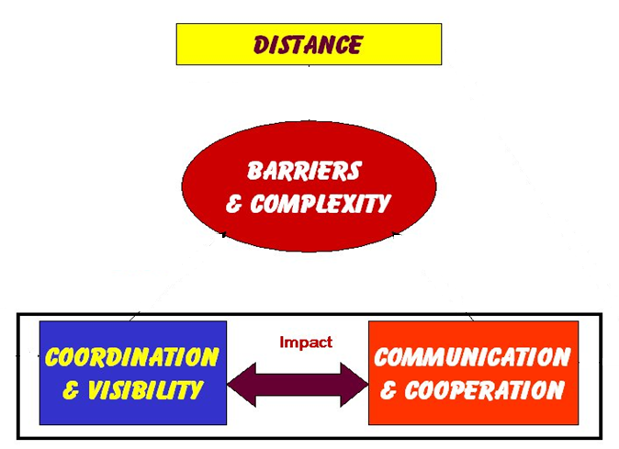
Challenges / Problems for Global Software Development
Introduces
Negatively Impacts
Negatively Impacts
In-terms of
Co-ordination
Management and control
Communication
Culture
Fear
Creates

Slide 15



Geographical distance challenges & Overcoming them
Communication:
Effective information exchange (less informal exchange, different languages, different domain knowledge, …)
Build a team (cohesiveness, “them and us” feelings, trust, …)
Coordination:
Task awareness (shared mental model, …)
Sense of urgency (perception, …)
Control:
Accurate status information (tracking, blaming, …)
Uniform process (different tools and techniques, …)
Cultural
Social background (directed, people orientation to task orientation …)
Attitude to authority, National culture, Cultural distance ..
Projection (different tools and techniques, …)

Slide 16


Overcoming Geographical distance challenges
Processes and Practices
Evolve process for effective Global Software Engineering
Collaboration Models
Teaming Models
Specific Practices
Communication practices
Project Management practices
Common ground
De-Coupling of work
Collaboration readiness
Technology readiness
Empowerment
Cultural Awareness
Communication

Slide 18
ITSM and ITIL
Unit 5

Slide 19
IT Service Management and IT Infrastructure Library

Slide 20
Life Cycles discussed till now
Introduction
Obsolescence
Growth
Design
Product Lifecycle
Architecture Design
Discontinuance
Maturity
Testing

Slide 21

Life Cycles discussed till now
Problem Identification
Delivery
Problem Analysis
Design
Architecture Design
Software Maintenance Lifecycle
Testing (Regression, System, Acceptance)
Design
Testing
Implementation

Slide 22
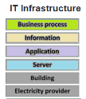
Applications in the IT Infrastructure use ITSM processes
Applications developed using the SDLC or being deployed in an organization typically will form part of or will influence the business processes of the organization.
These applications are deployed by the IT Operations or Infrastructure management teams in the company's infrastructure using IT services which typically use ITSM processes like Production acceptance process for deployment
Eg. Deployment of an application would have the following goals
Consistently and successfully deploy application systems
Support Increasing Deployment frequency
This would use the Production acceptance process which would ensure that the capacity is planned, a robust streamlined deployment process would be used.
Notes:
Some of the goals for the Deployment are to
Support faster time to market or usage
are supported by the IT services and create and manipulate information relevant to Businesses.
IT services, which encompasses deployment and other processes in the IT infrastructure, utilize the business and technical expertise, and enable organizations in the creation, management and optimization of or access to information and business processes.
1

Slide 23
ITSM Processes
IT services refers to, the application of business and technical expertise, to enable organizations in the creation, management, optimization or provide access to information & business processes.
Organization’s IT infrastructure will support the firm’s business and information systems strategy.
IT Infrastructure Systems Management is about how an IT organization manages IT services (for its customers) and provides a stable and responsive IT environment which supports or furthers the Business of the organization. This would mean looking at a group of products and processes which interact with each other to bring stability and responsiveness to an IT environment.
This leads to the objectives of IT Systems Management (ITSM)
In order to achieve these, IT infrastructure needs executive support, and Processes to support this
Availability Stability Scaling Responsiveness | Predictable Support Reduction in Cost Increased flexibility, Productivity, Customer Satisfaction Improved security, reliability and availability of IT infrastructure (secure)
Notes:
Some of the goals for the Deployment are to
Consistently and successfully deploy application systems
Support Increasing Deployment frequency
Support faster time to market or usage
are supported by the IT services and create and manipulate information relevant to Businesses.
IT services, which encompasses deployment and other processes in the IT infrastructure, utilize the business and technical expertise, and enable organizations in the creation, management and optimization of or access to information and business processes.
1

Slide 24
ITSM Processes
Sl. No | ITSM Process | Characteristics
1 | Availability Management | Managing expectation of the expected/agreed/guaranteed levels of functioning of the Services and Systems in a cost-effective, consistent and timely manner Uptime-Availability, Non-responsiveness-Downtime Achieved by 7 R’s
2 | Performance/Tuning | Maximize throughput Minimize response times Workload keeps changing and hence a challenge Performance management & tuning in an IT infrastructure can happen Servers, Disk Storage, Databases, Networks
3 | Production Acceptance | Production acceptance is a methodology and the process for consistently and successfully deploying application systems into a production environment, regardless of the platform where it sets a positive impression for the Application. It is also important to maintain integrity of the environment post the deployment.
Redundancy Reputation Reliability Repairability | Recoverability Responsiveness Robustness
Notes:
Some of the goals for the Deployment are to
Consistently and successfully deploy application systems
Support Increasing Deployment frequency
Support faster time to market or usage
are supported by the IT services and create and manipulate information relevant to Businesses.
IT services, which encompasses deployment and other processes in the IT infrastructure, utilize the business and technical expertise, and enable organizations in the creation, management and optimization of or access to information and business processes.
1

Slide 25
ITSM Processes
Sl. No | ITSM Process | Characteristics
4 | Change Management | Change is the modifications to and in the IT environment, which can impact the stability and responsiveness of the IT infrastructure environment. Change is done for adding value (responding to change, managing risks or for resource optimization) or it could be to fix things with goal of reducing disruption and enhancing effectiveness (bringing in stability and responsiveness) Change Management involves controlling change (Request, Prioritize, approve) and Change co-ordination (Collaboration, Schedule, Communicate and implement).
5 | Problem Management | Process used to identify, log, track, resolve, and analyze problems impacting the IT services. A call initiated by a customer as an incident, gets analyzed and logged as a problem or resolved as a Service request. Service desk -advantages and disadvantages of a segregated or an integrated Service desk.
6 | Storage Management & Network Management | Approaches to ensure performance, Integrity, reliability and recoverability of storage data Approaches for maximizing reliability and utilization of the network
7 | Configuration Management | Focused on accurately documenting the interrelationships of varying versions of infrastructure hardware and software.
Notes:
Some of the goals for the Deployment are to
Consistently and successfully deploy application systems
Support Increasing Deployment frequency
Support faster time to market or usage
are supported by the IT services and create and manipulate information relevant to Businesses.
IT services, which encompasses deployment and other processes in the IT infrastructure, utilize the business and technical expertise, and enable organizations in the creation, management and optimization of or access to information and business processes.
1

Slide 26
ITSM Processes
Sl. No | ITSM Process | Characteristics
8 | Capacity Management | Predicts when, how much, and what type of additional resources would be needed, to support accurately forecasted workloads of Services
9 | Strategic Security Management | Intended to set up security controls to safeguard the availability, integrity, and confidentiality of designated data & programs against unauthorized access, modification, or destruction Achieved typically through Security testing, managing security incidents, security review etc
10 | Business Continuity Process | Business continuity is a methodology to ensure the continuous operation of critical business systems in the event of widespread or localized disasters to an infrastructure environment. Business continuity management includes identification of the disasters (as a risk), contingency planning (mitigation for the risk) for the Business to get back functionally or for Business recovery and plans for getting back to a functional state till the Disaster recovery can happen.
11 | Facilitates Management | Focused on accurately documenting the interrelationships of varying versions of infrastructure hardware and software.
There can be relationships between each of the processes, which is used to prioritize the processes which would have the most impact, and help in prioritizing focus on the processes.
Notes:
Some of the goals for the Deployment are to
Consistently and successfully deploy application systems
Support Increasing Deployment frequency
Support faster time to market or usage
are supported by the IT services and create and manipulate information relevant to Businesses.
IT services, which encompasses deployment and other processes in the IT infrastructure, utilize the business and technical expertise, and enable organizations in the creation, management and optimization of or access to information and business processes.
1

Slide 27
ITIL
ITIL (IT Infrastructure Library) is a framework or a set of IT service management (ITSM) best practice processes that focuses on aligning IT services with the needs of business
ITIL describes best practices which are not organization-specific or technology-specific, but can be applied by an organization for establishing & integration with the organization's strategy, delivering value, and maintaining a minimum level of competency.
It allows the organization to establish a baseline from which it can plan, implement, and measure. It is used to demonstrate compliance and to measure improvement.
It is a public domain framework for practitioners
ITIL started as a process-improvement initiative in mid 1980’s in Great Britain with ~40 Volumes or Books and later moved to ~60 volumes and currently is in ITIL 4 version (published in 2019)

Slide 28
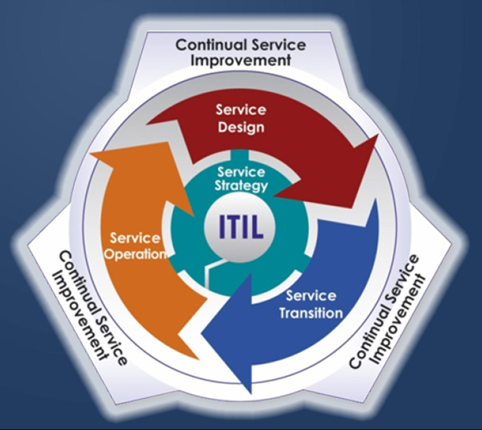
ITIL - 3
ITIL 3 is available as a Service lifecycle with the following steps
Service strategy: Understands organizational objectives and customer needs and provides strategic guidance for investments in services. Includes service value definition, business-case development, service assets, market analysis, and service provider types
Service design: Turns the service strategy into a plan for delivering the business objectives, technology service delivery
Service transition: Develops and improves capabilities for introducing new services into supported environments. It relates to the delivery of services required by a business into live/operational use encompasses the "project" side of IT
Service operation: Manages services in supported environments. Aims to provide best practice for achieving the delivery of agreed levels of services both to end-users and the customers. Includes Ops management, Service management, Service desks etc.
Continual service improvement: Achieves incremental and large-scale improvements to services

Slide 29
ITIL - 4
Latest ITIL 4 has 34 practices categorized into
General management practices including architecture management, measurement and reporting, risk management and project management
Technical management practices which include Infrastructure and platform management and software development and management
Service management practices like Availability management, Capacity management and performance management, Incident management etc.

Slide 31
DEVOPS
Unit 5

Slide 32
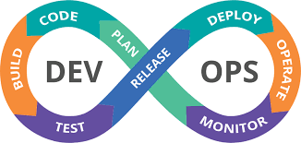
Introduction to DevOps
Notes:
IT Infrastructure Systems Management is about how an IT organization manages IT services (for its customers) and provides a stable, available responsive IT environment at minimal costs which supports or furthers the Business of the organization while factoring in Scaling, Security etc
1

Slide 33
IT Operations
IT operations is the overarching term for the processes and services administered by an organization's information technology (IT) department.
IT operations includes administrative processes and support for hardware and software, hosted in the organization for both internal and external clients.
Important roles of the IT operations team include tech management, infrastructure management, IT support functions, Quality assurance and reiteration for the products developed or being deployed that they meet the customer's needs and expectations.
Notes:
<number>

Slide 34
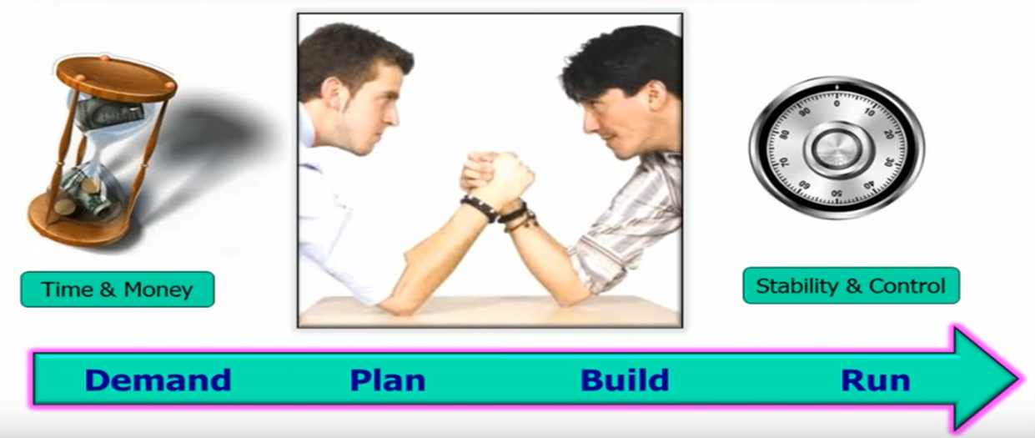
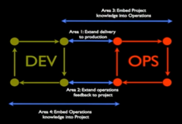
DevOps
DevOps is the combination of cultural philosophies, practices, and tools that increases an organization’s ability to deliver (Deploy and Support) applications and services at high velocity and become more effective

Slide 35
DevOps
Its the blending of the terms development and operations, meant to represent a collaborative or shared approach to the tasks performed by a company’s Application Development teams (following SDLC) and IT operations teams which sets-up processes and services to support utilization and management of the companies IT Infrastructure (hardware and software), for both internal and external clients.
The term DevOps is also used as an operational philosophy that promotes better communication and knowledge between the above two Dev and Ops teams
Notes:
There are tools commonly used in DevOps environments.
These include continuous integration and continuous delivery and continuous deployment tools, with an emphasis on task automation.
Tools towards real-time monitoring and incident response systems as well as collaboration platforms
<number>

Slide 36
What is DevOps : Context
DevOps looks to make the enterprise processes faster, more efficient, and more reliable with the intention of increasing the Business value
Repetitive manual labor, which is error prone, is removed whenever possible
DevOps in a sense is an extension of the agile way of doing things where you can deliver functionality incrementally and at a faster rate. It also follows one of the agile manifesto principles which is Individuals and interactions are more important over process and tools.
Deployment systems, maintained by DevOps engineers, can make the deliveries not only at the end of Scrum cycles with a periodicity of two to four weeks but even faster (could even be many times a day) and be more efficient.

Slide 37
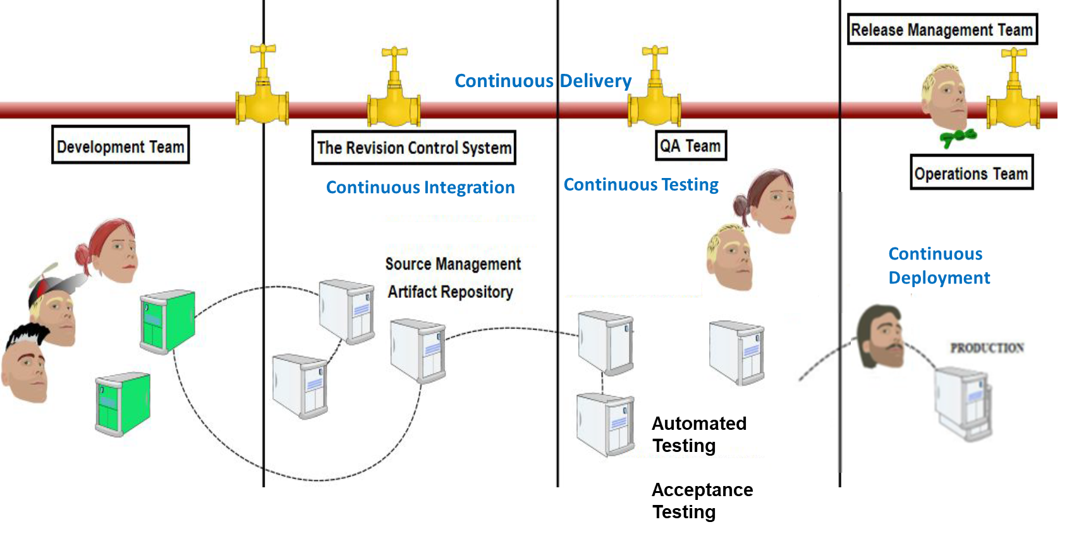
DevOps Pipeline and Supporting Pillars
There are four common themes or pillars that any team or organization looking to implement DevOps needs to focus its time and resources on.
Collaboration
Affinity
Tools
Scaling
The combination of these pillars enables addressing of the cultural and technical aspects of this DevOps organization

Slide 39
DevOps
Unit 5

Slide 40
Terminologies, Concepts and Processes
Notes:
IT Infrastructure Systems Management is about how an IT organization manages IT services (for its customers) and provides a stable, available responsive IT environment at minimal costs which supports or furthers the Business of the organization while factoring in Scaling, Security etc
<number>

Slide 41
Concepts, Terminologies and Processes associated with DevOps
Recap of some of the terminologies used as part of DevOps
SDLC (Waterfall Model, Agile Approach and model)
Operations Methodologies (ITSM, ITIL)
SCM terminologies associated with Development, Release and Deployment concepts
Version Control Continuous Integration Continuous Build | Continuous Delivery Continuous Testing Continuous Deployment
Version Control
Version control systems like Git record changes to files or sets of files stored within the system.
Developers can make changes individually or within groups and save these changes through commits or revisions within the system in one way or another.
Ability to commit, compare, merge & restore past revisions to objects to the repository allows for richer cooperation and collaboration within and between teams and minimizes the risk.

Slide 42
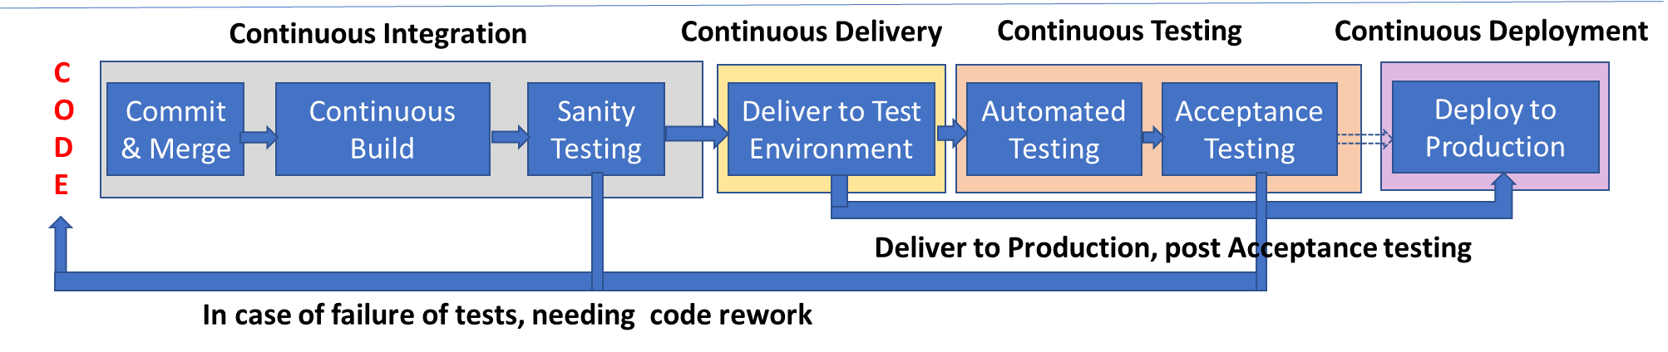
DevOps – Pipeline : Continuous Integration (CI)
Continuous Integration (CI)
CI involves continuously merging the code written by developers with a mainline or “master” branch, frequently throughout the day.
Developers take a snap shot or branch code from a master branch and work on their individual components and check-in and merge the changes back into the (mainline or “master” branch from where they had taken a snap shot). Other developers too take a snap shot and do the same and this can happen concurrently.
This merging of the code can happen multiple times through the day or in some periodicity and during merge if they find a merge conflicts, its resolved and then the code is merged
Notes:
and each revision, along with metadata is stored
<number>

Slide 43
DevOps Pipeline : Continuous Integration .. (Cont.)
Continuous Integration (CI) (Cont.)
If the code changes are not integrated frequently, then this could lead to a large big bang integration which stands the risk of more intricate integration conflicts or incompatibilities during the merge and can lead to the failure of the Build system or issues in time, effort and cost overruns in the project
Continuous integration has the benefits of
Change sets being small and hence work for resolving conflicts would be small & incremental.
Supports detecting of issues early
Avoids difficult integrations, increased visibility and communications
Reduced debugging time
These frequently merged code will need to be Built, and post the Build validated for Sanity.
Notes:
and each revision, along with metadata is stored
<number>

Slide 44
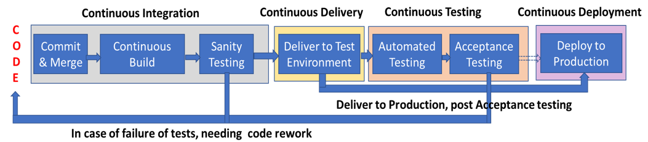
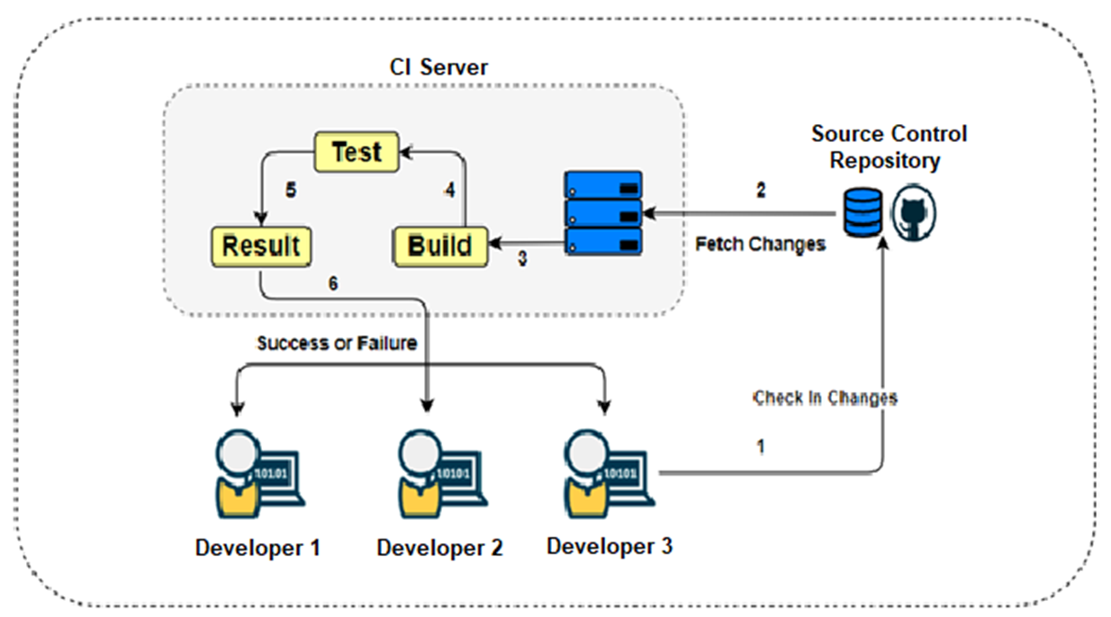
DevOps Pipeline : Continuous Integration .. (Cont.)
Continuous Build
Build involves compiling, handling dependencies and involves generating an executable product. This may also involve running some static code analysis tools like Lint.
Sanity Testing
The executable built, is run with some sanity tests to ensure that the total compilation is successful, the dependencies are all resolved and the executable is in an executable state.
Notes:
and each revision, along with metadata is stored
<number>

Slide 45
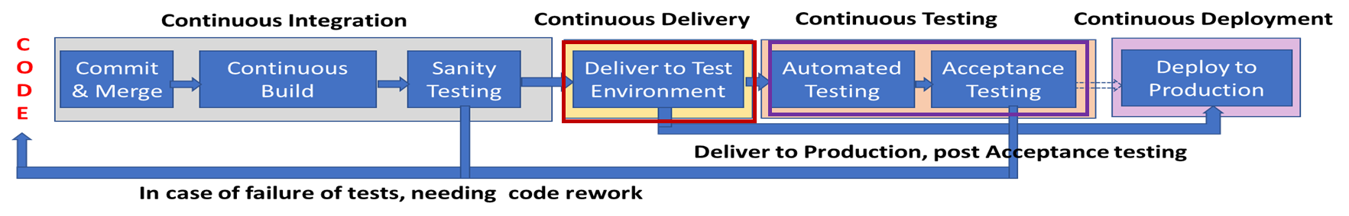
DevOps Pipeline : Continuous Delivery
Continuous Delivery is the frequent shipping of code to a given environment (such as test or production)
Post every merge, build and Sanity testing, the Integrated bits are ready to be deployed, this supports release of the new changes to your test teams/customers quickly in a sustainable way.
This process may be triggered by the last step in the continuous integration process and supports delivery either to the test or to the production environments and setup for this
This drives the Business outcomes like deploy on demand, and supports faster time to market and of higher quality and may use tools like Jenkin Plugins to do this

Slide 46
DevOps Pipeline : Continuous Testing
Continuous testing is the process of executing predominantly automated tests as part of the software delivery pipeline for validating the code to ensure that the application works as envisaged and is free of bugs or defects and can be continuously deployed
These tests are typically designed to be executed with minimum wait times and provide the earliest possible feedback & support detection (or prevention) of the risks that are most critical for the business or organization that is associated with the software release candidate.
Tests are executed post continuous integration and could be executed daily or commonly many times a day, every time that the application is updated into the version control system.
Entry criteria for testing by the QE process groups would be successful completion of the unit and integration tests.
In the QA environment, these could include some static code analysis and validation of both functional requirements and non-functional requirements including security testing, performance testing, etc. and acceptance tests.
Metrics from here could be used to re-examine and optimize the process itself, including the effectiveness of the tests.

Slide 47

DevOps Pipeline : Continuous Deployment
Continuous Deployment (CD) is a software release process that uses the delivery mechanisms for deploying the automated testing validated product, immediately and autonomously to a production environment.
Typically used in highly mature DevOps teams
Significant number of times, validated integrated components are batched together and are then deployed into customer environment
This moves away from the approach of moving code from one machine to another, checking if it works as expected (typically erwror prone and resource-heavy process). Now, tools can automate this entire deployment process, which allow engineering organizations to focus on core business needs instead of infrastructure overhead.

Slide 48
DevOps and Agile
DevOps is a culture and approach which looks to remove the silos of Development activities of building a product and the Operations activities of deployment, support and upkeep. This also focusses on increasing the velocity of deployment of products facilitating it by communication, collaboration, automation, usage of tools and integration among IT professionals.
Agile is a methodology or a type of iterative SDLC which as a process, supports changes, ensures more collaborations between developers and other stakeholders, reduces the planning overhead and delivers products or part of products periodically say once 2-4 weeks.
DevOps focuses on constant testing and delivery while the Agile process focuses on constant changes.
The target area of Agile is Software development whereas the Target area of DevOps is to give end-to-end business solutions and fast delivery.
DevOps focuses more on operational and business readiness whereas Agile focuses on functional and non-function readiness.

Slide 50
DevOps
Unit 5

Slide 51
Pillars of DevOps
Notes:
Pick from chapter 2,3,4,5 of Effective DevOps
<number>

Slide 52
Pillars of DevOps
There are four common themes that any team or organization looking to implement DevOps needs to focus its time and resources on.
The four pillars of effective DevOps are
Collaboration
Affinity
Tools
Scaling
The combination of these pillars will enable addressing of the cultural and technical aspects of an organization
Although the first two are norms towards interpersonal interactions, they are important to reduce and avoid inter-team and interpersonal conflicts
This could be started one at a time and extended to all four pillars

Slide 53
Pillars of DevOps : Collaboration
Collaboration is the process of working towards a specific outcome through supporting interactions and the input and support of multiple people & groups.
Cooperation of software development and operations teams is essential before one team can successfully work with another team with a different focus
Teams that don’t work well on an individual or intra-team level can have challenges towards working well individually and at the inter-team level.
Effective collaboration involves
Communication
Equal participation
Theory of Mind, which is the ability to recognize ones perspective and understanding that others have distinct and different perspective based on their own context

Slide 54
Pillars of DevOps : Collaboration – Cont.
Considering different aspects of getting people to work together more effectively could be by having
A shared goal
Empathy of a collaborative culture through effective communication
Teams are effective when based on relationships built on trust, empathy & reciprocity including
Empathy that there can be different perspectives based on the different backgrounds in terms of gender, culture, language, background of families, background of their previous experiences, their qualifications, their job profile etc.
That people have different personal and professional goals and needs.
That people have different cognitive styles or ways of processing things, learning things or how they engage in their work.
Where hierarchies are less emphasized
Notes:
These could be like introverts-ambiverts-extroverts or could be Asker-Guesser, Purist-pragmatist, Analytical-critical-Internal thinkers etc.
Supporting Opportunities to gain competitive advantage like mentorship, sponsorship and education
Negotiations, Building Empathy
<number>

Slide 55
Pillars of DevOps : Affinity
There needs to exist a strong relationship between individuals, teams and departments along with collaborative relationships to ensure the Dev and Ops groups work together. This is achieved by having teams with strong affinity between them.
Affinity is the measure of the strength of the relationship between individuals, teams, business units, and even companies.
Building Affinity is the process of building these inter-team relationships, navigating differing goals or metrics while keeping in mind shared organizational goals, and fostering empathy and learning between different groups of people.

Slide 56
Pillars of DevOps : Affinity (Cont.)
Affinity can be measured by several factors like
Shared time
Intensity of the relationships
Reciprocity of shared stories
Reciprocity of support
and are achieved by having
Shared values
Consistent team culture
Team cohesion
which acts as a common ground.

Slide 57
Pillars of DevOps : Tools
Tools are important in the DevOps environment as they act as an accelerator, driving change based on the current culture and direction
Tools & their ease of use impacts the acceptance and proliferation of specific aspects of the culture as they become the common language between teams
In order for initiatives to be successful tools which are only beneficial for a subset of the teams or lack of tools would get in the way of individuals or teams working well together.
If the cost of collaboration is high, not investing in tools (or worse, investing in poor tools) raises this cost.
E.g. of tools : System provisioning tools, Build Tools, Automation tools, Testing tools, Monitoring tools, Log extraction tools, Deployment tools etc.
All of those which enhance the effectiveness of DevOps

Slide 58
Pillars of DevOps : Scaling
Scaling has a focus on the processes and pivots that organizations must adopt throughout their lifecycles.
Scaling takes into account how the other pillars of effective DevOps can be applied throughout organizations as they grow, mature, and even shrink in large organizations.
There are different considerations, both technical and cultural, for organizations operating at different scales, and considerations for organizations that do not fall into the category of “typical” smaller DevOps cultures will need to be examined.
Scaling could be for Organization, infrastructure, teams (hiring, retention, outsourcing), Complexity, Workload

